Slide 1

UNIVERSITY OF HYDERABAD
SESSION : 2022-24
PROJECT ON : HTML, JAVASCRIPT, CSS AND PHP (with MySQL)
PROJECT NAME : STUDENT’S HOSTEL GUIDE
GUIDED BY : SAI PRASAD SIR AND VISHWANATH SIR
PRESENTED BY : GARIMA CHOURASIYA(22MCMC15) and
NEETA KALA(22MCMC14)

Slide 2
HOME PAGE
Home page have three tabs :
Home
Students Complaints : To register a complaint the user have to click on student complaints, then user is redirect to another page where :
1. user can login only if he/she has already registered.
2. If user is not registered yet then he can go through the signup option.
Admin : Here admin can see all the complaints with all the details of the complainers through his login id and password.
Sign out : This will end the session and redirect the user to the home page.

Slide 3
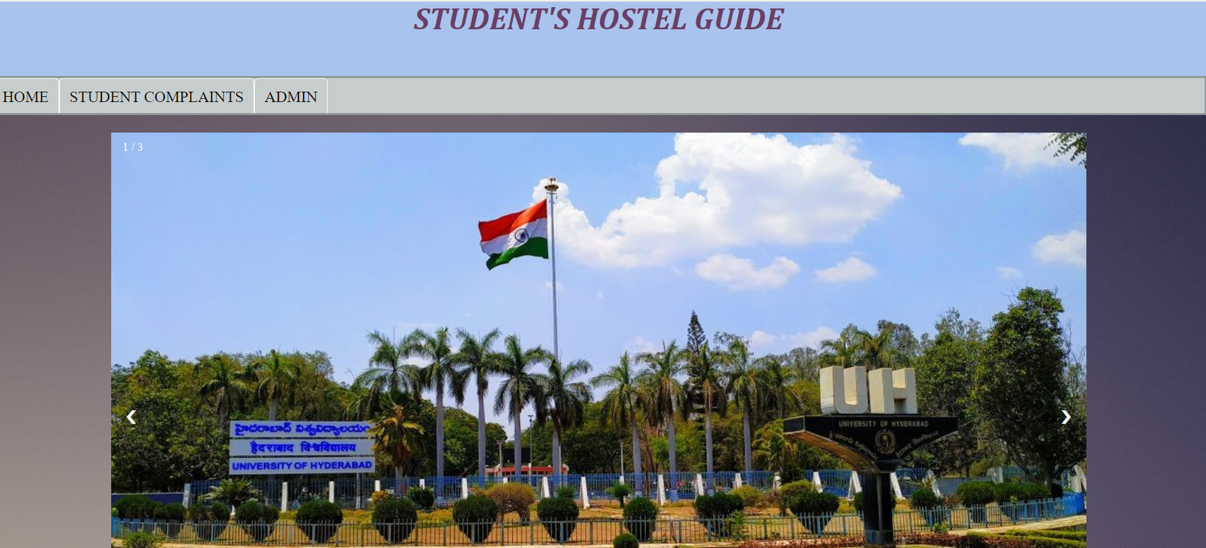
HOME PAGE

Slide 4
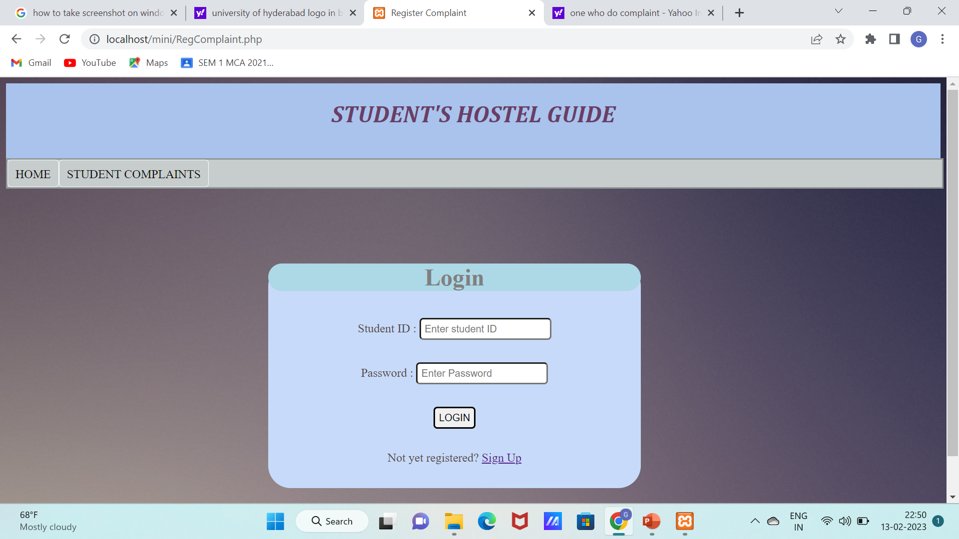
STUDENT’S COMPLAINT TAB
LOGIN PAGE

Slide 5
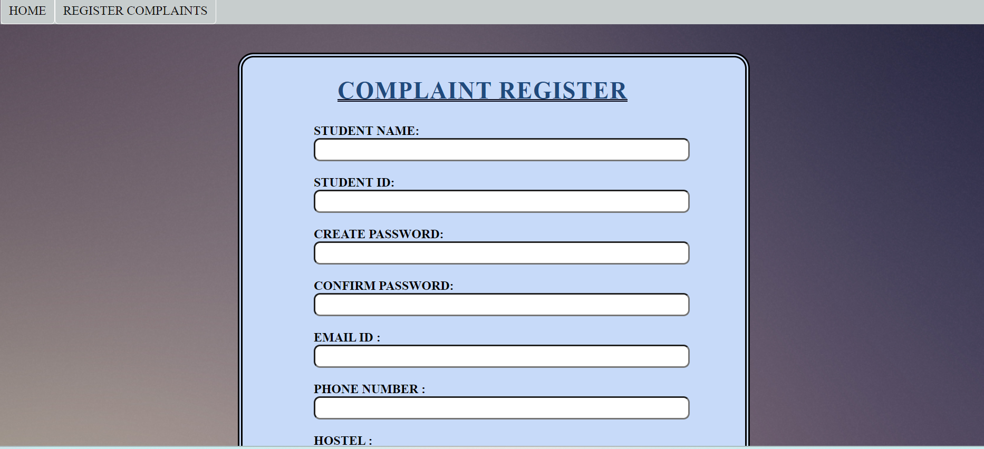
SIGNUP PAGE

Slide 6
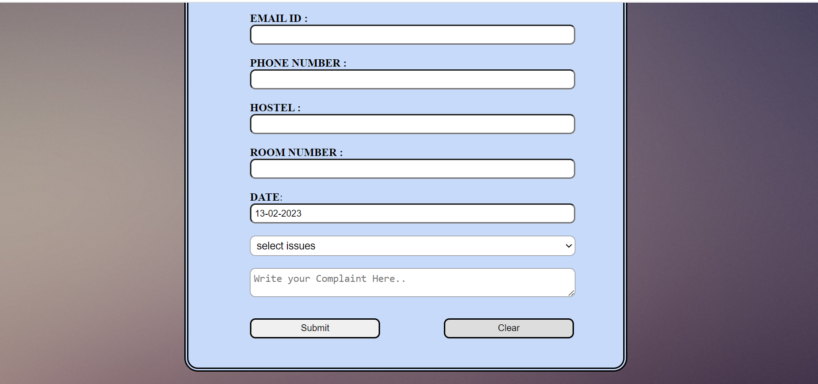

Slide 7
After logging by the user, he/she can see the previous complaints.
If a user is not a registered then user must choose the signup option and then after then user can login and see the complaint and
To raise a new complaint the user have to click on raise complaint tab.

Slide 8
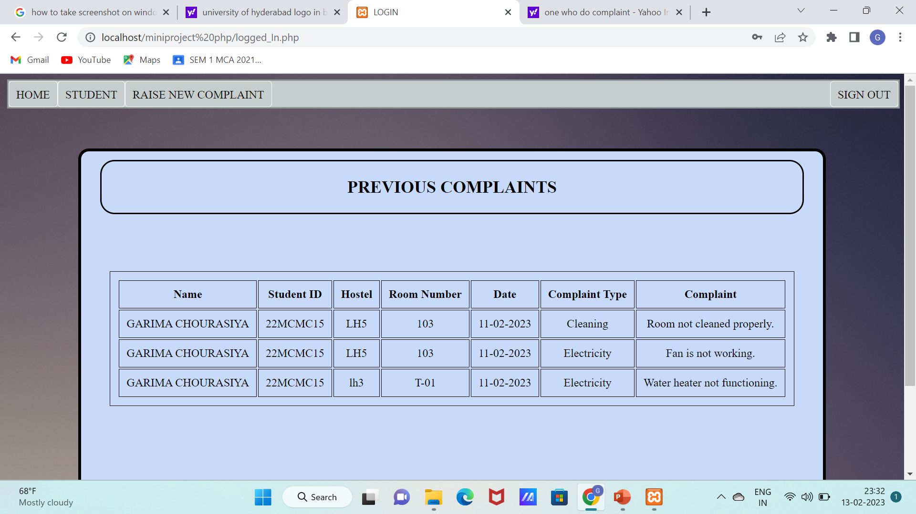
PREVIOUS COMPLAINTS

Slide 9
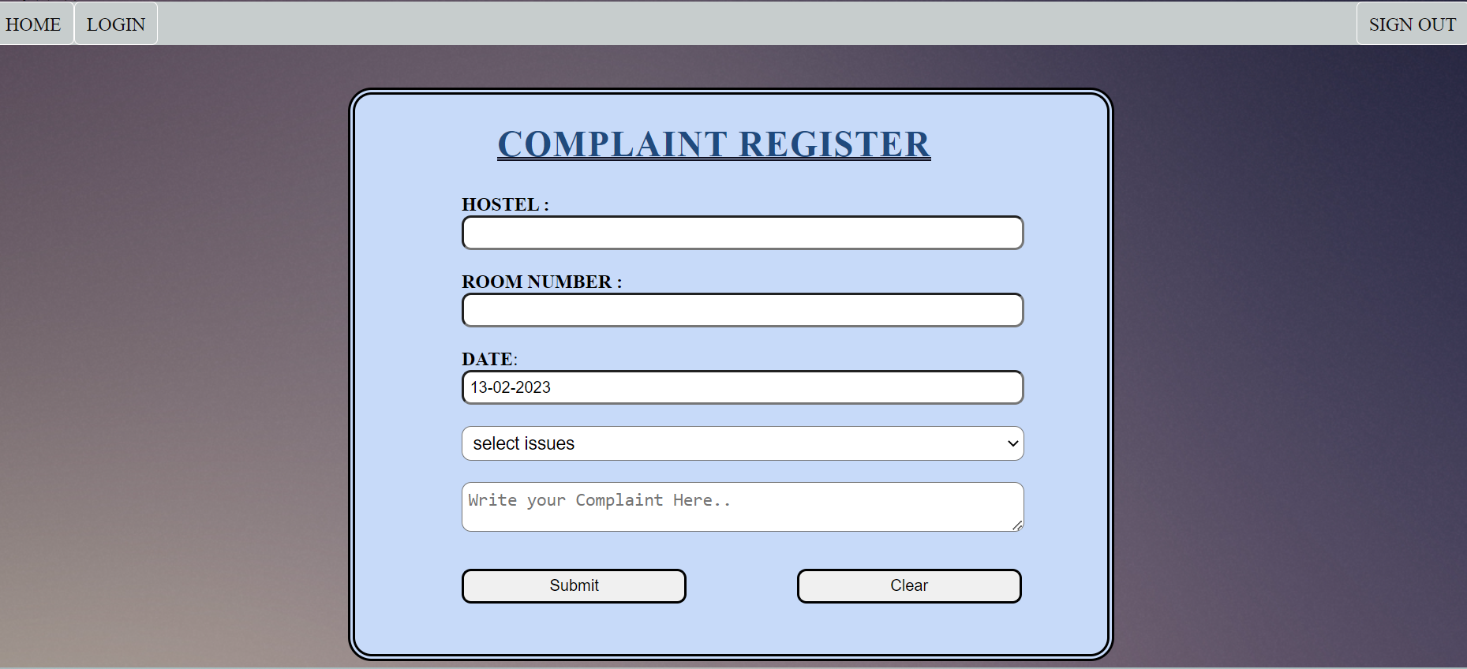
RAISE NEW COMPLAINTS

Slide 10
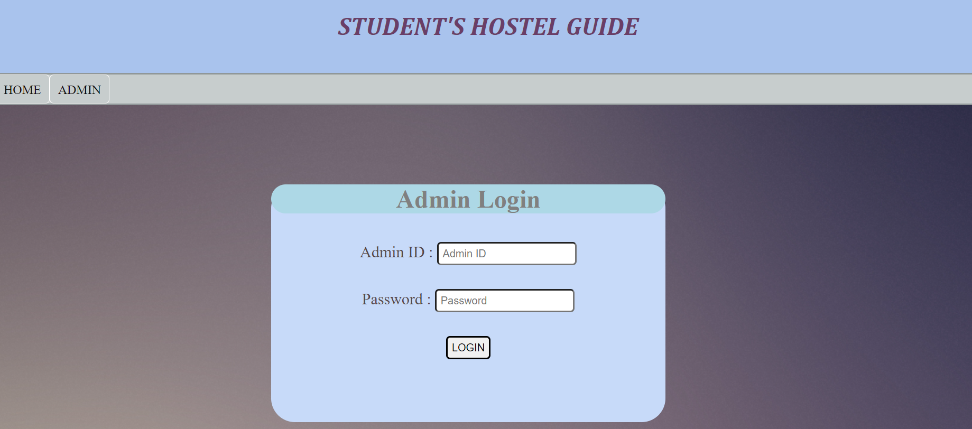
ADMIN PAGE

Slide 11
